Slide 1

Information Technology
WMS Evaluation- 3PL
November 13, 2012
Notes:
We are proposing modeling WC1 as an additional building in the current installation.
This will make the installation trivial since no separate database instance would be required.
The disadvantage would be that this new building would be visible to all FDC staff. Conversely, FDC buildings will be visible to WC1 staff.

Slide 2
System Flow
ASN 856
Invoice 810
Inovis Translator
Account
Maidenform- Vision ERP
Order 850
Allocation
Shipment
Confirmation
Receipts
Inventory
Adjustments
DCMS
Receiving
Storage
Picking
&
Packing
Shipping
DCMS Connect Reporting

Slide 4
Desirable Goals
Minimum need for Scanning. Compromised accuracy acceptable.
Transparent Interfacing with Vision. Should require no intervention from local users.
Process optimization is desirable but not an overriding concern. No location tracking or pick path guidance.
Minimum IT infrastructure. No mobile devices.

Slide 5
Throughput Requirements
Inventory in Building | 6 million pieces
Receiving volume | 10 containers per day, 1500 cartons per container.
Picking volume | 110,000 pieces per day
Shipping volume | 15 containers per day
All numbers represent peak volumes
Notes:
These were gathered in conversation with Juan. He is the operations manager at Fairway.

Slide 6
DCMS Lite Process Overview
Receiving
Importing Pickslips
Picking
Shipping
Exporting Pickslips

Slide 7
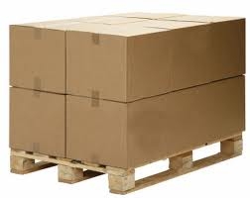
Receiving Process Flow
Create pallets while receiving and locate them in Pick Area WFP
Process Carton ASN
Receive Cartons
Picking Area (WFP)
Notes:
Should we be scanning pallets to locations? Juan thinks so.
Should we keep separate inventory of pick area and carton area? This would mean restocking.
Receiving. Scan each carton. Exact same process as FDC. Cartons will show up in a staging area called RST.
Expected volume: 26,000 cartons per week or 6,000 cartons per day. Assuming average of 2 sec per carton receive time, this should take 3000 sec = 1 hour of
receiving per day.
Receiving will create SKU pure pallets. These will show up in some staging area. We somehow need to auto restock.
Thought: Can we bypass carton scans? Option to Quick Receive
Inventory report (Number?) will indicate stock in RST.

Slide 8
Custom Programming - 1
Possibility of Quick Receive UI which will not require individual carton scans.
Script to auto restock cartons to pick area after they have been received.

Slide 9
Import Pickslips from Vision
Process | Remarks
Import Pickslips using existing scheduled job | Job execution frequency and timing may need to be adjusted to eliminate interference with FDC processing
Automatically create Pick Waves for WC3 pickslips | One Pick wave per PO will be created
After the scheduled job runs, WC3 users will see a list of pick waves which need to be picked and shipped.

Slide 10
Custom Programming - 2
Script to auto create buckets, one per PO/DC.
Pick Wave UI can still be used to modify/delete these buckets when and if necessary

Slide 11
Picking Process Flow
Import Pickslips from Vision
Auto Create Buckets
Batch Print UCC/CCL Labels
Manually Pick Boxes based on CCL Labels
Ship. Print BOL.
Random Box QC
Export Shipments to Vision
Notes:
Once pickslips are imported, pick waves will be automatically created based on predefined rules, such as one wave per customer.
Pickslips will be printed to a laser printer. Need to estimate the volume of pickslips which will be printed per day.
Create boxes program will allow quick creation of multiple similar boxes.
Box QC

Slide 12
Picking Setup
Locations will be numbered.
SKUs will be assigned to each location.
(Optional) The travel sequence of the locations will be defined
Pickers will drop SKUs in cartons rolling on conveyor

Slide 13
Packing Process
Supervisor selects the PO to process
Picker presses a button
All CCL and UCC labels print
She picks right size cartons and packs them based on the contents displayed on the CCL.
Affixes labels to the carton and drops them at the QC station.
When the PO is fully picked, supervisor selects next PO and the process repeats.
Label Summary with carton sizes prints as header.

Slide 14
Custom Programming - 3
Special UI for bulk printing operation highly recommended, though not required. Will optimize print speed and reprint capabilities.
Hook to fully pick PO immediately after it is printed.
Modify CCL to display pick location and carton size.
Modify Bucket Selection dialog to display cancel date and provide cancel data filters
Printed Summary header before label set.
Notes:
Do this by 10th

Slide 15
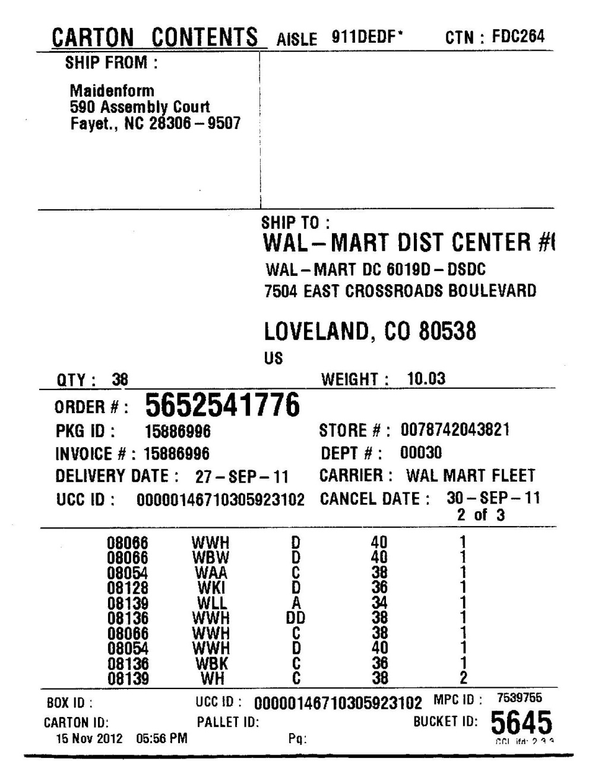
Sample CCL Label
CCL lists the contents of the box and must be affixed to each box.
This sample does not show the pick location, but we will be including it in the first column.

Slide 16
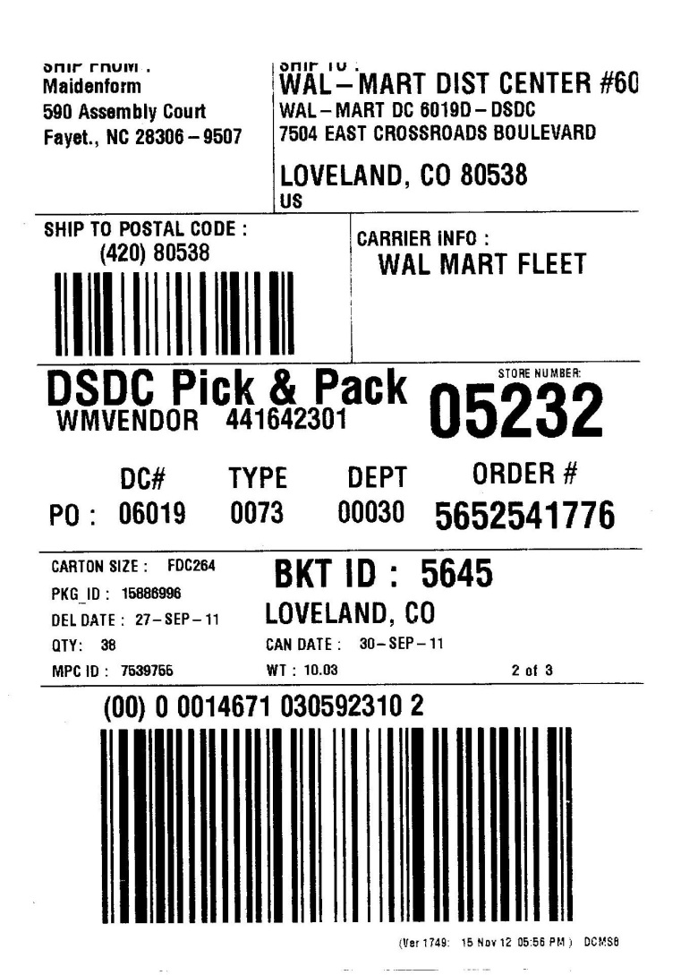
Sample UCC Label
This label meets Walmart requirements. It must be affixed to the box.
The bar code identifies the box and will be scanned during the close picking process.

Slide 17
Picking
CCL will be used to perform box level picking.
CCL will list the SKU, pieces, and the location where the SKU can be found.

Slide 18
Box QC
All picked boxes will be presumed accurate.
Box QC will be used to randomly check the contents of the box.
When pickers under pick, Box QC must be used.
Discovered issues will also be corrected here

Slide 19
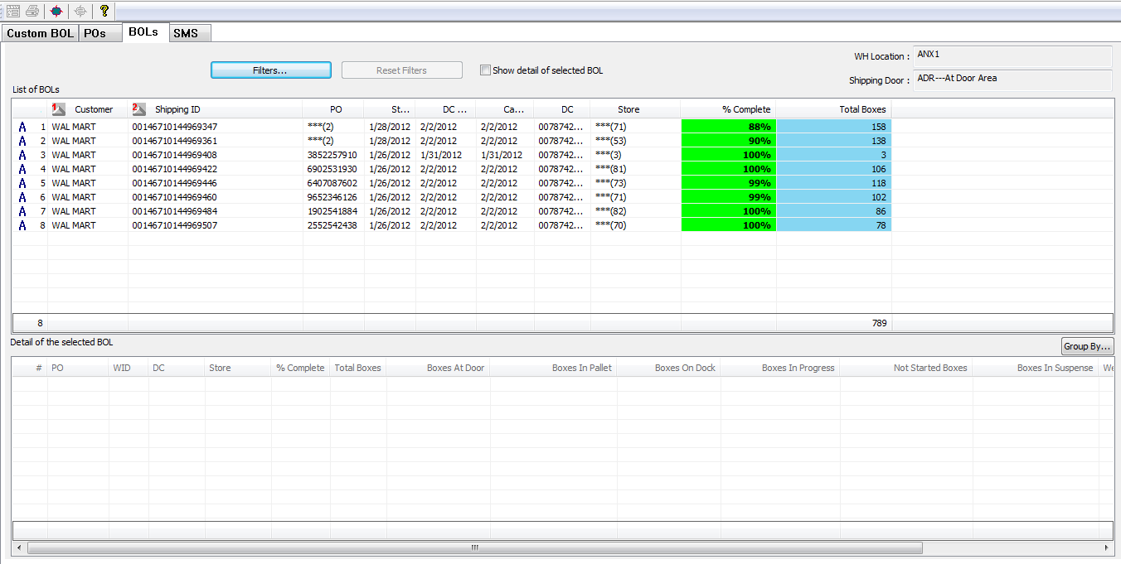
Screenshot - Shipping
All BOLs are displayed along with their progress status. BOLs were created automatically when the pickslips were imported. The user simply has to mark the BOLs as shipped. Options available to cancel unpicked boxes.

Slide 20
Export Pickslips to Vision
This will be a routine process, no different from today.
Vision will process shipments from LA2 exactly as it processes shipments from FDC.

Slide 21
Connectivity Requirements
Broadband Connectivity
Site to Site VPN Connection
Zebra printers
Laser pick ticket printers
DCMS web
This will enable
Importing/Exporting Pickslips
Printing UCC/CCL
Changing box status to Picked
Shipping BOLs
It is possible to perform all of these functions remotely if connectivity problems are encountered.

Slide 22
Reports
40.07: Receiving Report
10.84: Details of BOLs exported
10.86: Details of PD Exported For Each Customer
10.88: Cancelled PD Report
20.05: SKU details of PDs imported on a date
110.08 : Open Order Drill down Report
130.28 : SKU Shortage report
130.03 FPK Inventory Report
140.02: Open Bucket Summary (Order aging)
110.16 Estimated cartons and weight

Slide 23
Inquiry
DCMS Lite provides a rich set of Inquiry functions.
Floor users can scan any bar code at any time and the system will display all relevant information.
Similar to “Price Check” functionality in super markets.

Slide 24
Custom Programming - 4
All Reports currently provide option to display data for All Buildings or Single Specific Building.
Would now need an option to display data for Multiple Selected buildings.
This will enable FDC users to summarize data for just their buildings.

Slide 25
Next Steps
Onsite review with business and Fairway
Test simulation
Engage Eclipse for timeline and delivery milestones
Cost evaluation
Signoff by IT management and Business

